Slide 1
Ministry of Jal Shakti
Department of Water Resources, RD & GR
Water Information Management System (WIMS)
National Water Informatics Centre

Slide 2
Online WIMS Training Session
National Water Informatics Centre(NWIC)
Topic : Station Management , WIMS MIS Dashboard , Email & SMS and Manage Contacts
Date of Training: 23/08/2022
Venue: Online Webinar
Organised By : NWIC
.

Slide 3
Welcome
.

Slide 4
Water Information Management System (WIMS)
National Water Informatics Centre(NWIC)
Contact Details: 9717135438
Trainer Name: Megha Panwar
Department: National Water Informatics Centre(NWIC) Email Id: helpdesk-nwic@gov.in

Slide 5
WIMS Live Application URL- https://india-water.gov.in/wims/login.xhtml
WIMS – Water Information Management System

Slide 6
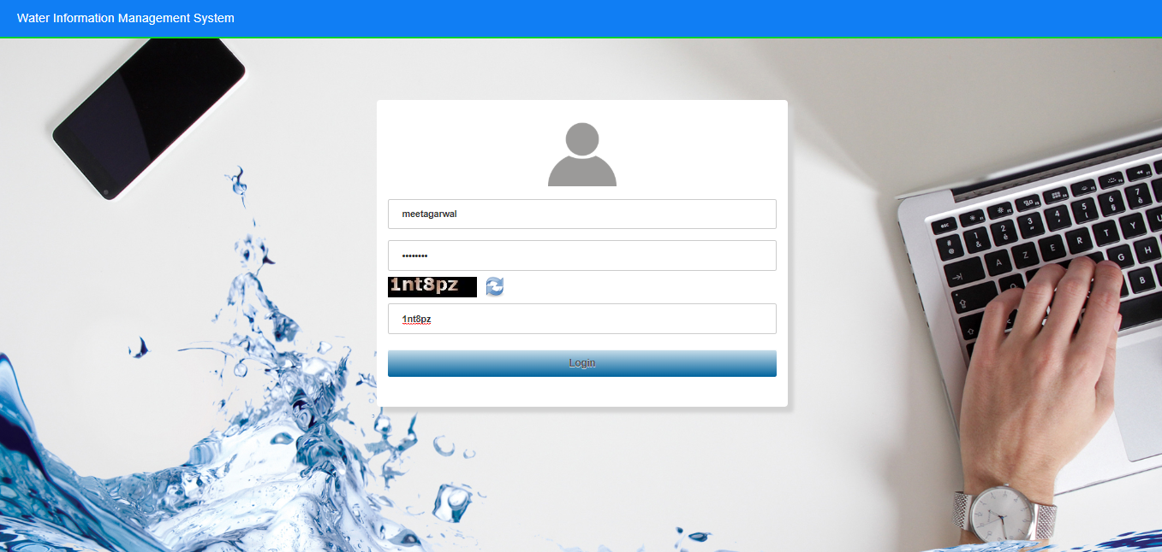
Login into WIMS (Water Information Management System) Enter Login, Password & Captcha details based on the User Agency. Click on Login button

Slide 7
WIMS – Water Information Management System
Station Management (Surface Water / Ground Water) in WIMS
How to Search the existing stations ( Surface Water / Ground Water ) in WIMS
How to add New Station ( Surface Water / Ground Water)
How to edit or update the site/station(Surface Water / Ground Water) details in WIMS
How to assign the data type on site or station ( Surface Water / Ground Water)

Slide 8
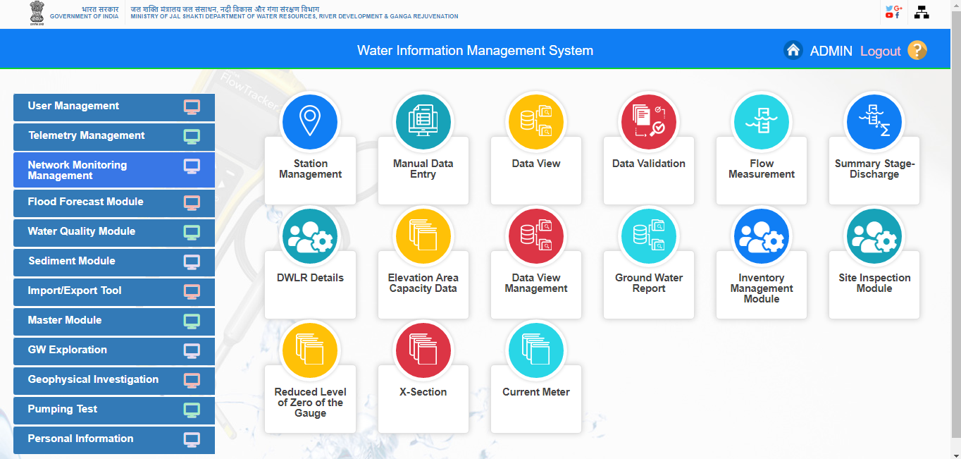
Station Management (Surface Water / Ground Water)

Slide 9
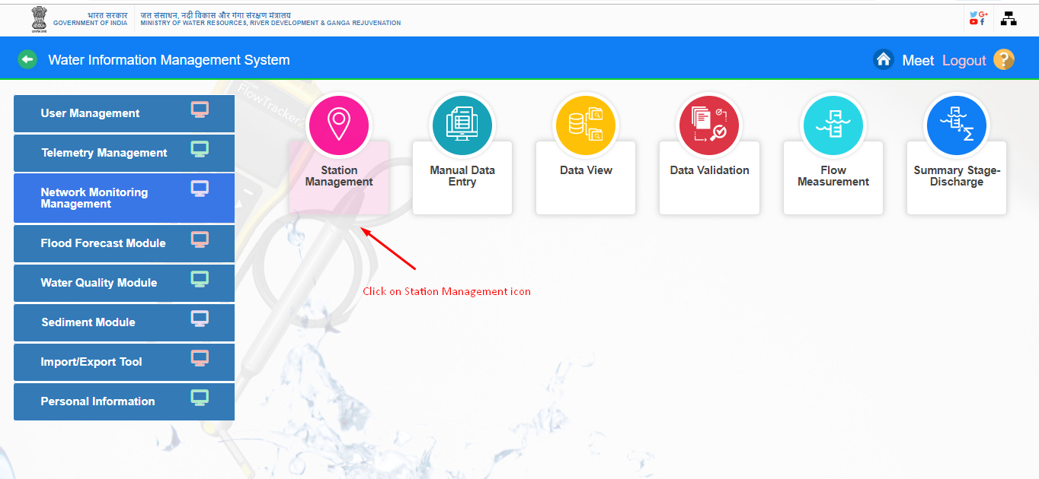
Go under “Network Monitoring Management “ Module ,
then Click on “Station Management “icon

Slide 10
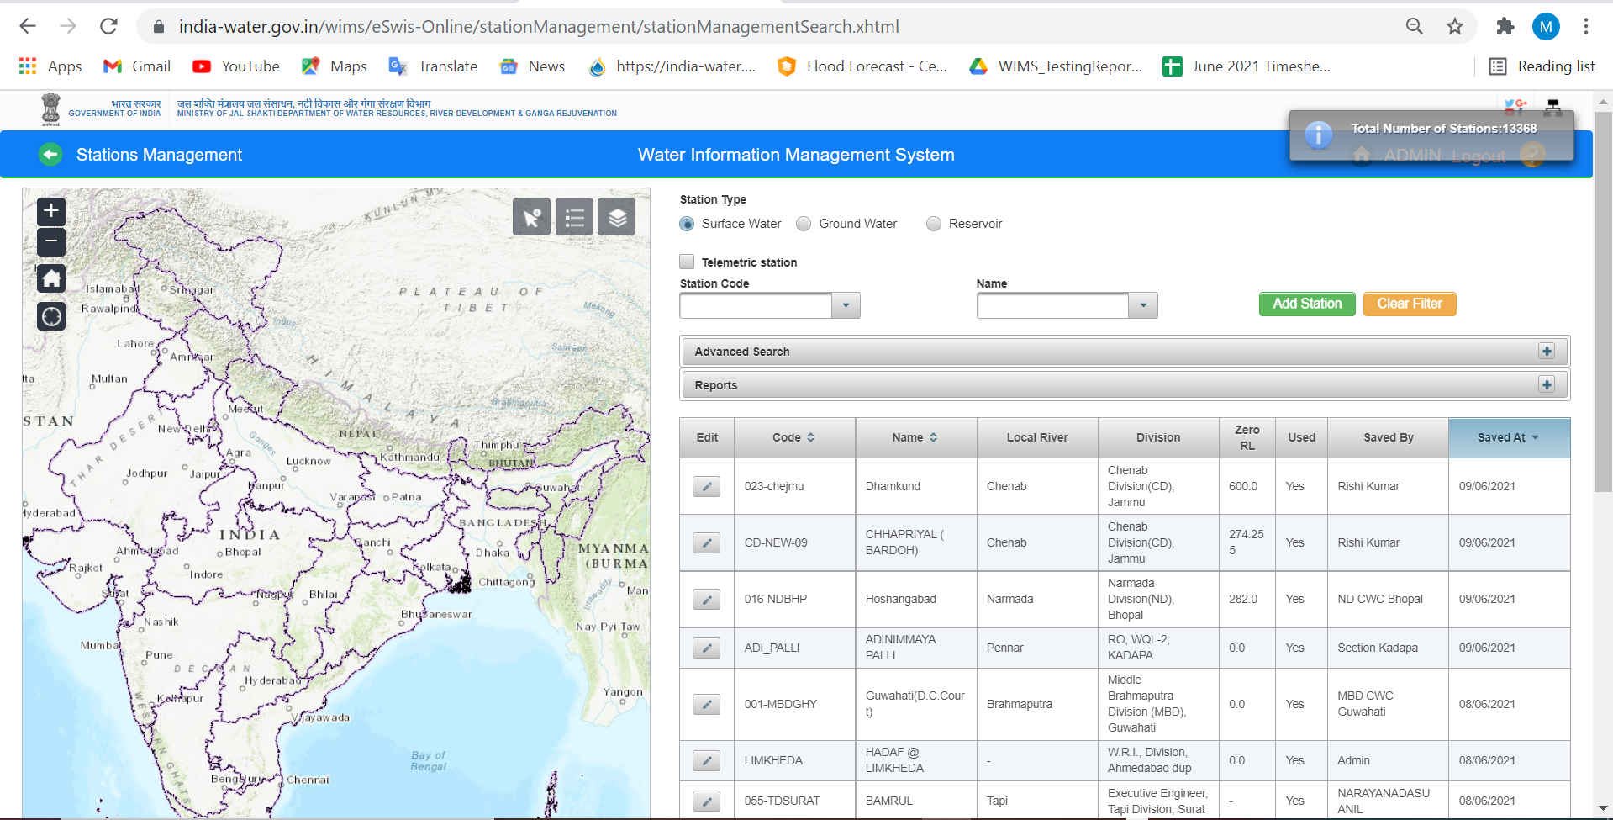
Search the station Surface Water in WIMS

Slide 11
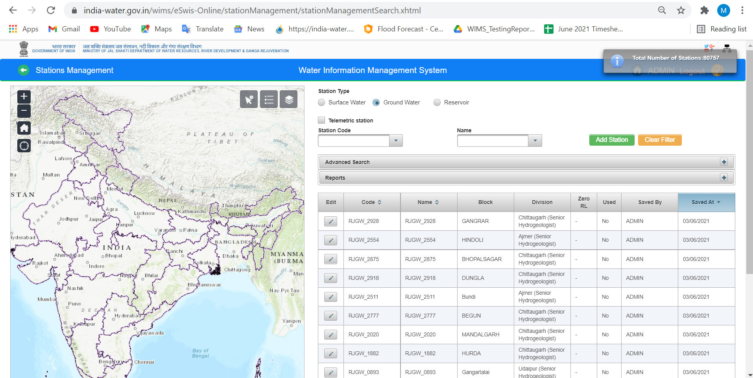
Search the station Ground Water in WIMS

Slide 12
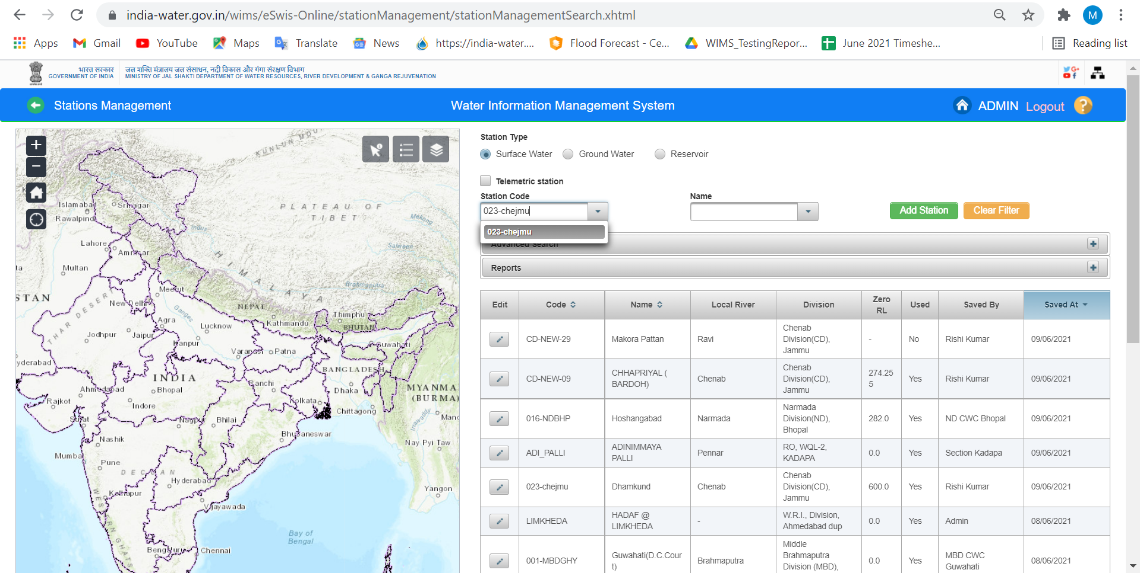
Search by Station Code: Enter minimum 3 digits/ characters for searching the Station Code for both surface and Ground water Station Types.

Slide 13
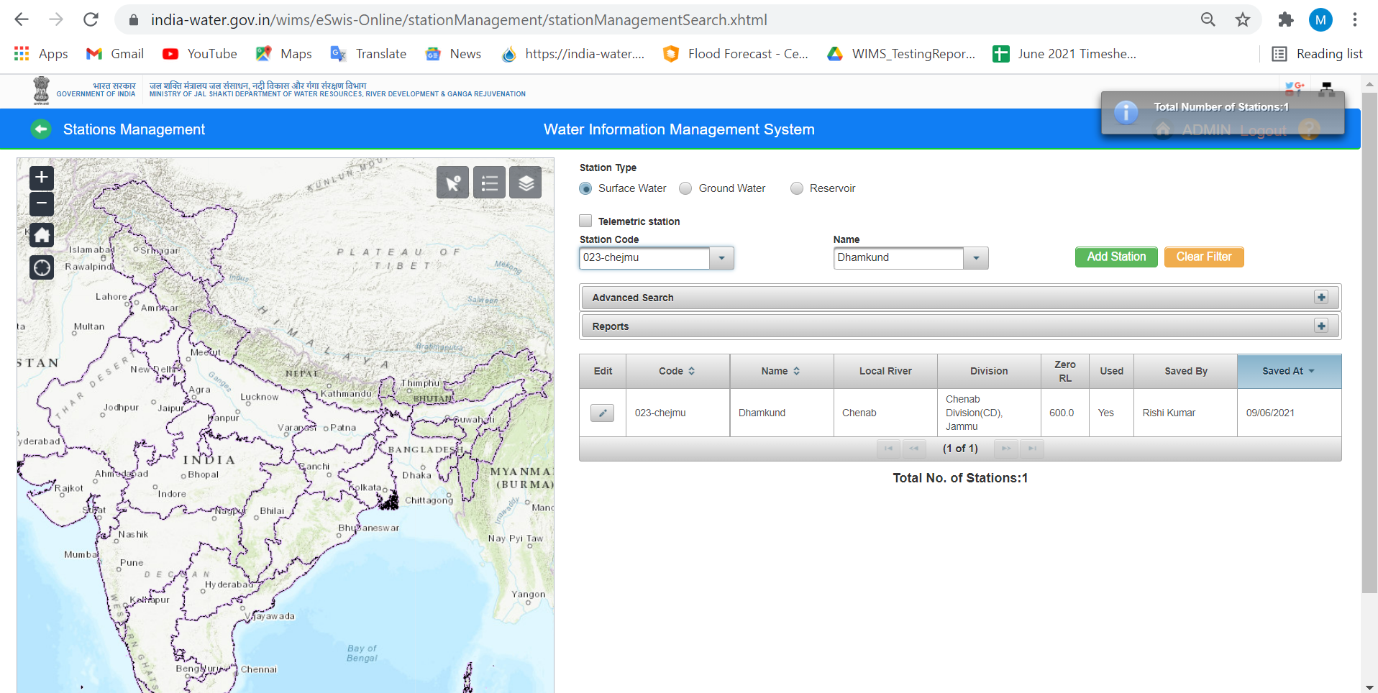

Slide 14
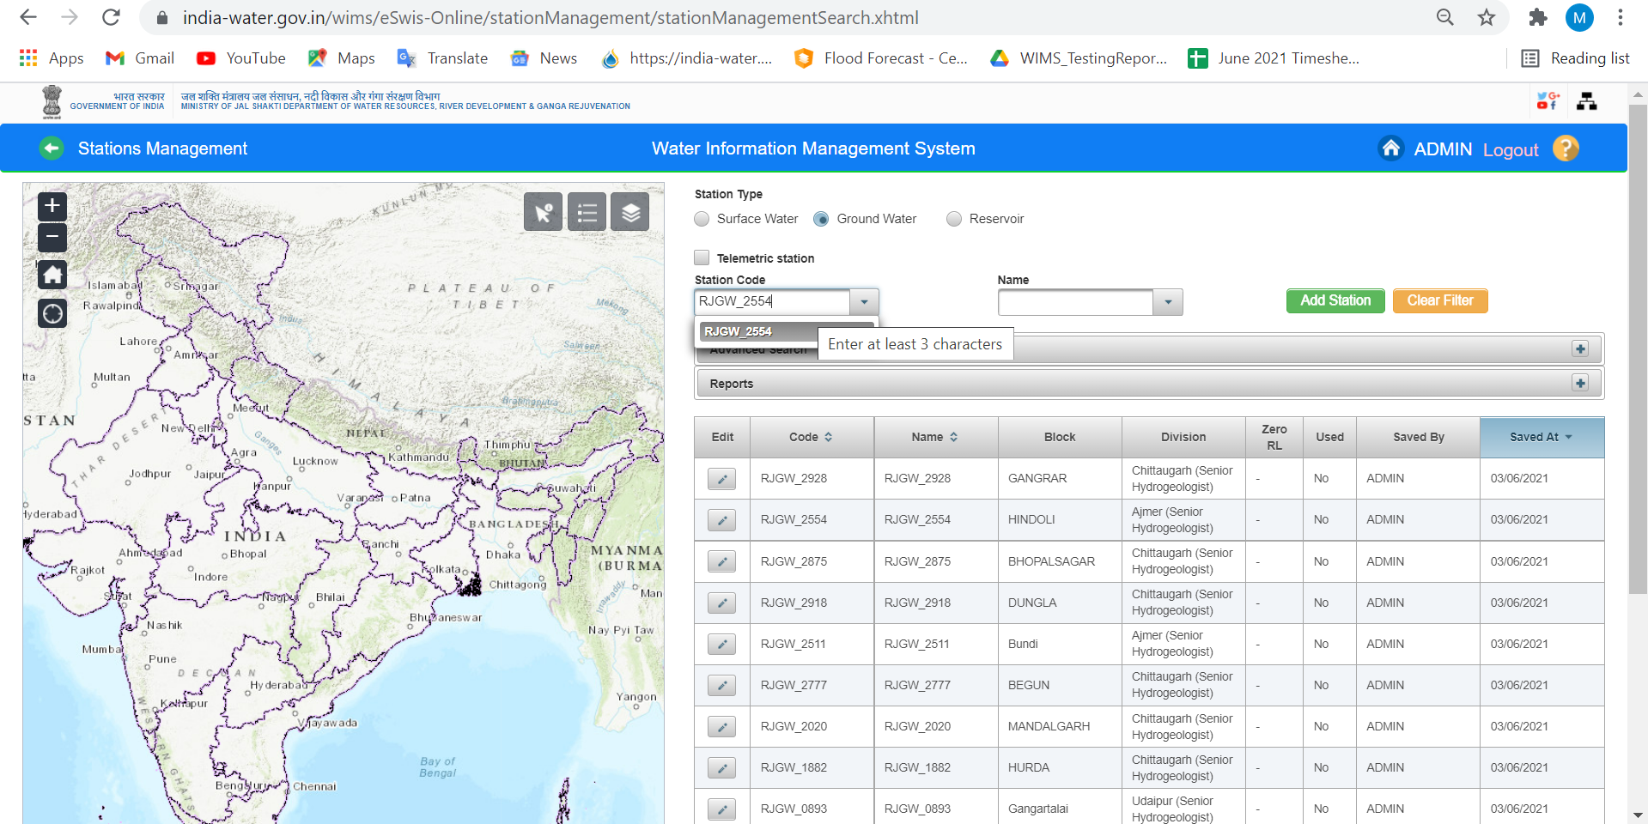

Slide 15
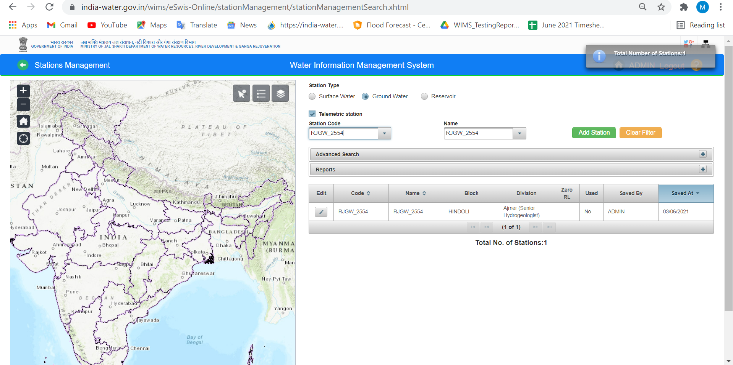

Slide 16
Search by Station Name : Enter the station name at least 3 characters to search for both surface and Ground water Station Types.

Slide 17
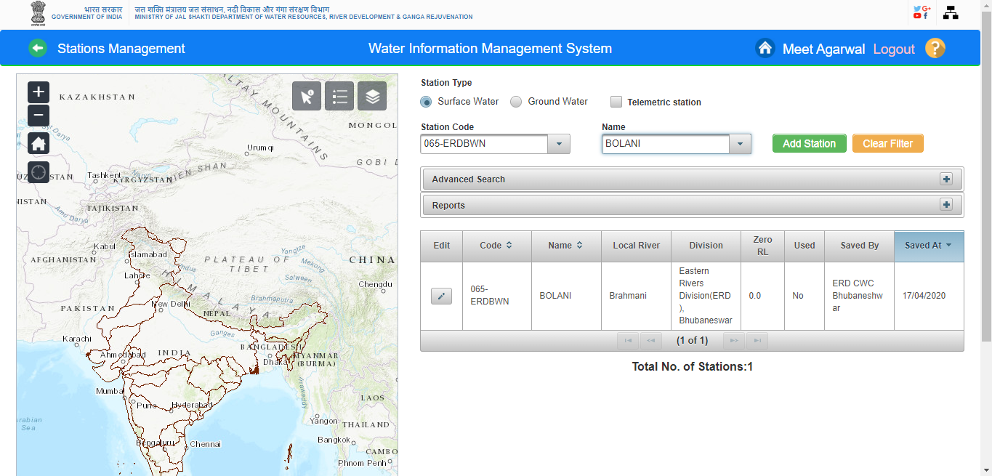
Station code and Name is displayed in Station Data Table on station management page

Slide 18
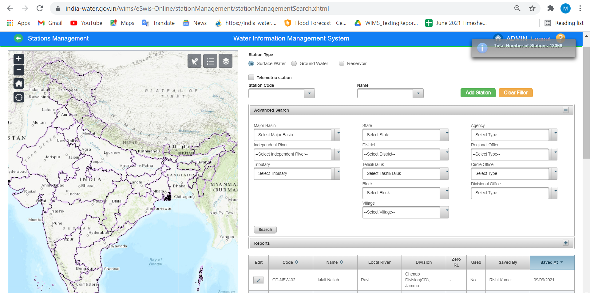
Advanced Search Option- Basin/State/Agency Wise

Slide 19
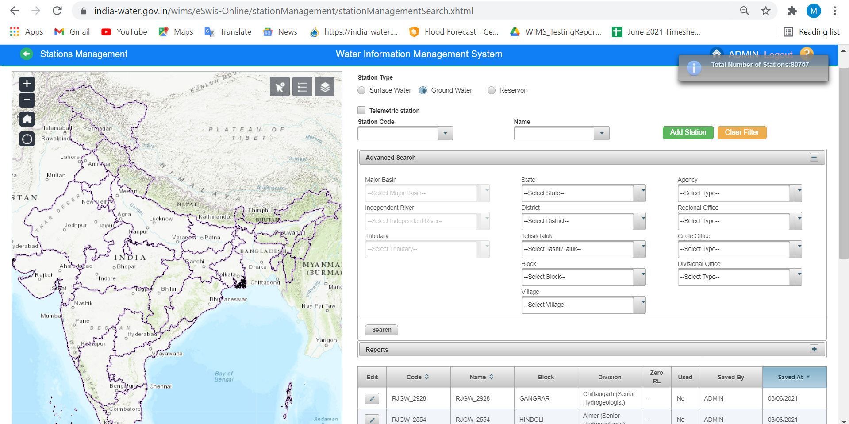

Slide 20
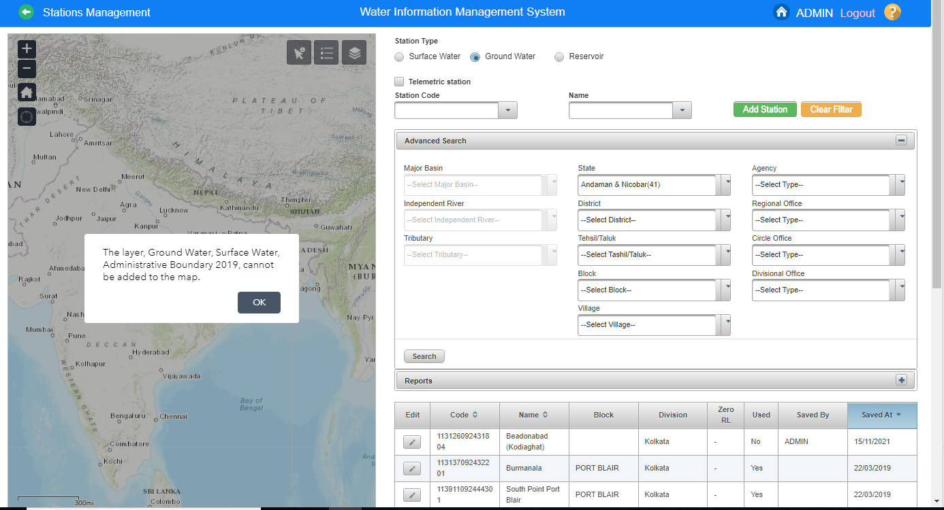
Advanced Search Option- Basin/State/Agency Wise

Slide 21
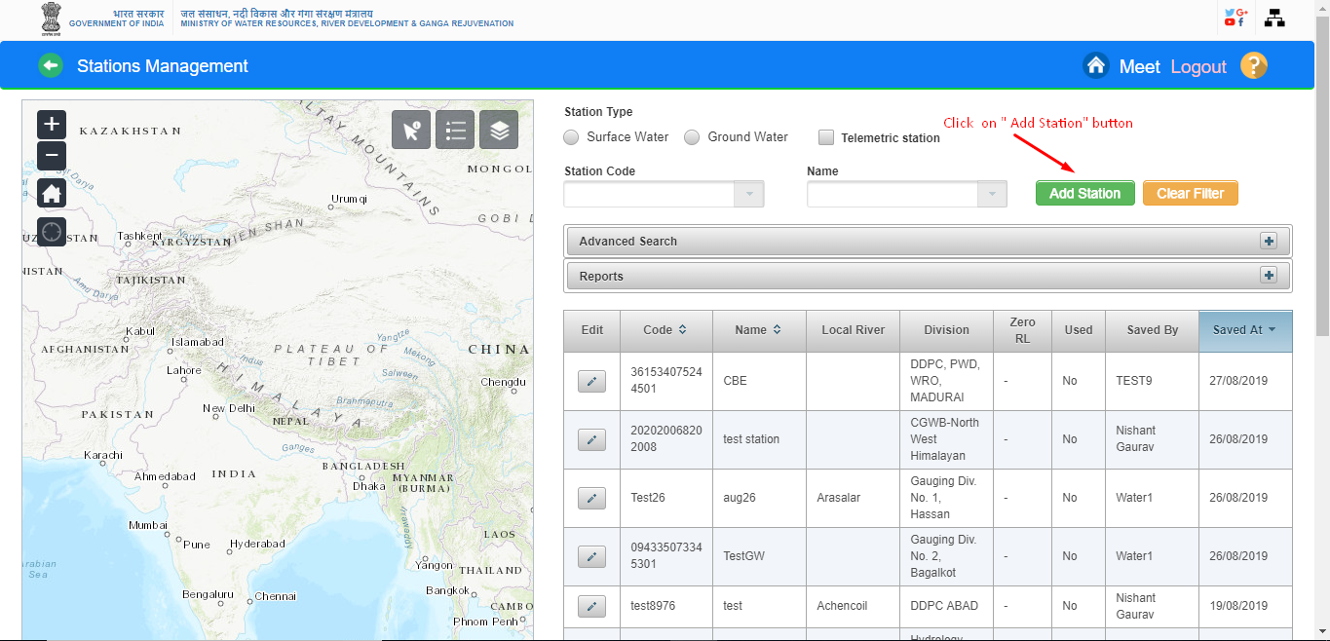
ADD NEW STATION : Nodal Agency has to add the station details for both type of stations ( Surface Water and Ground Water) from Station Management section in WIMS Software

Slide 22
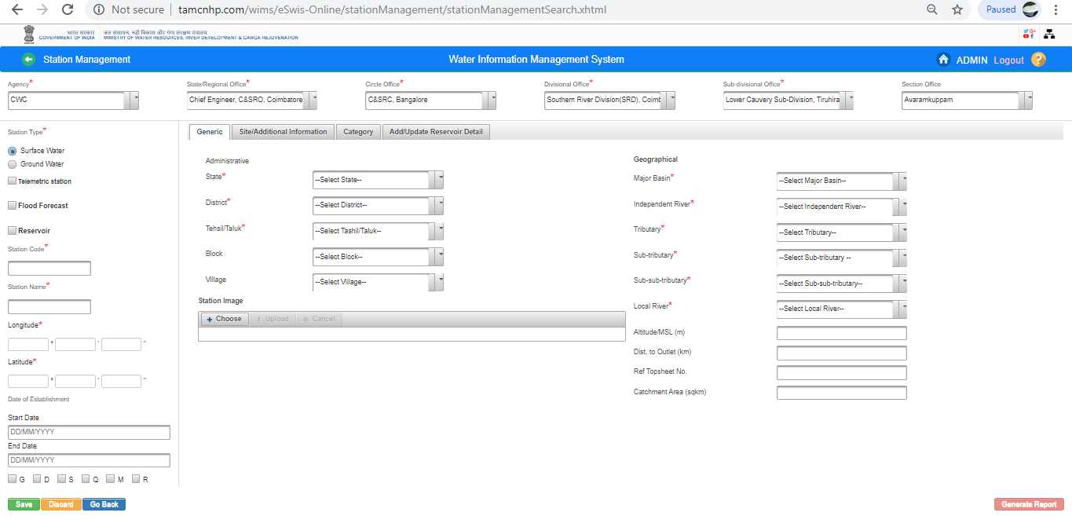
For Surface Water Select Type of station which you want to create (Manual station Telemetry Station or Reservoir or Flood Forecast ) Page in Station Management

Slide 23
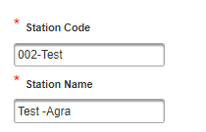
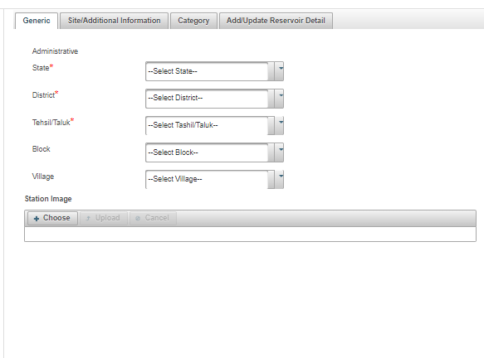
Enter New “ Station Code and “ Station Name” which is get from the available details list for adding the new station in WIMS
Fill all administrative details for example - Select State, District & Tehsil/Taluk from “ Administrative” under “Generic” Tab for Surface Water.

Slide 24
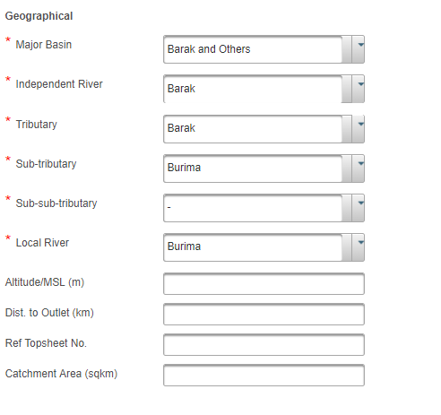
8. Add “ Geographical” mandatory details and fill all the mandatory fields and necessary fields values under “Geographical” section

Slide 25
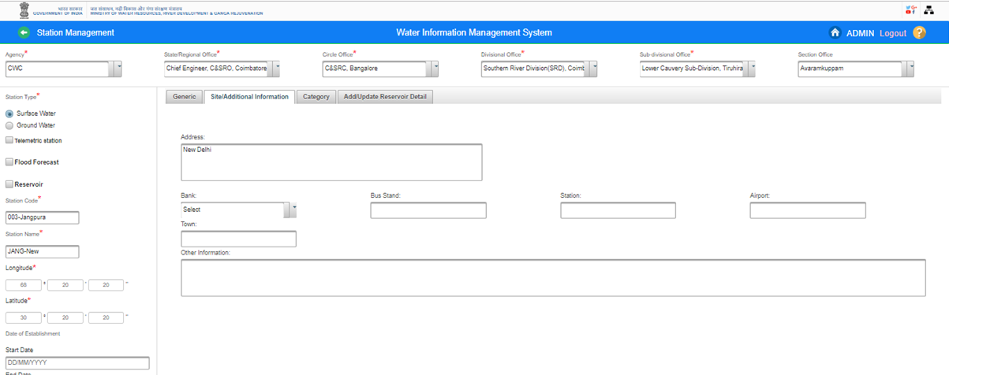
11. “ Add Address “ from “ Site & Additional Information Tab” on “Add Station” Page under Station Management

Slide 26
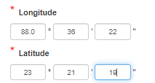
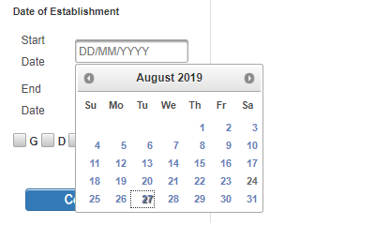
9. Add “Longitude” and “Latitude” details
10.Select or Enter “ Date of Establishment” of Start Date and End Date

Slide 27
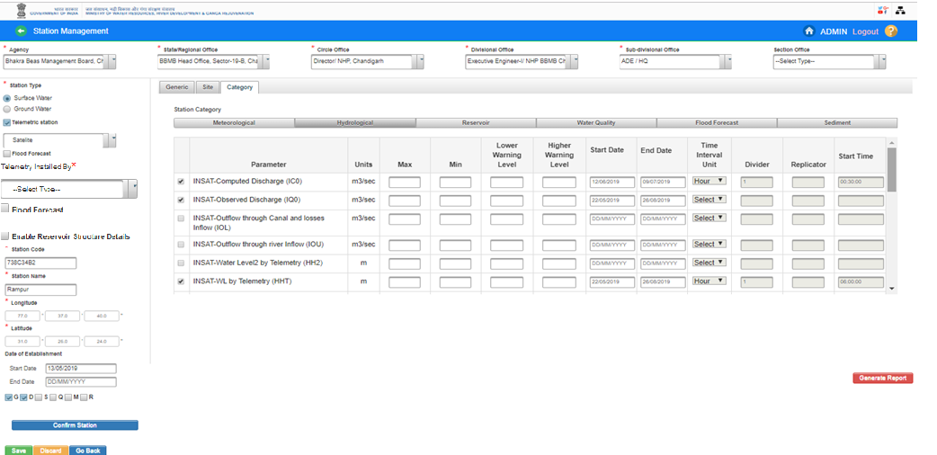
Add Data Type-
Click on “Category “ Tab and Select the respective “Category” from this section, User Agency can add “Sensors” or “Data Type” details as per the available details for sensors against the particular station at the time of station configuration or after adding the station as well.

Slide 28
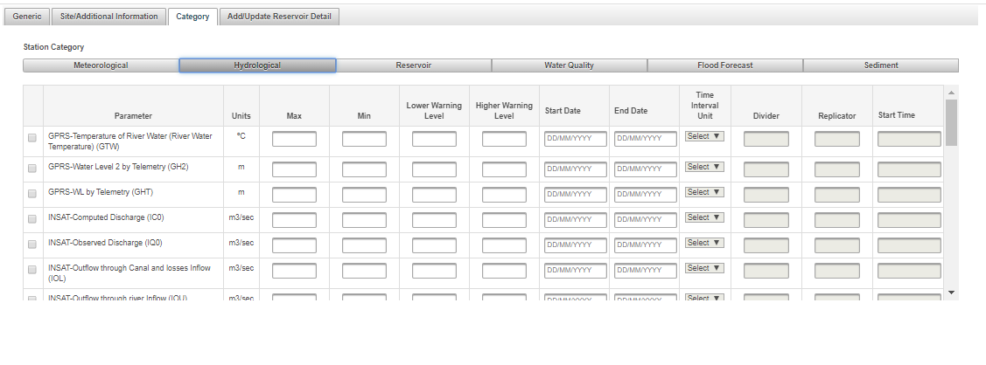

Slide 29
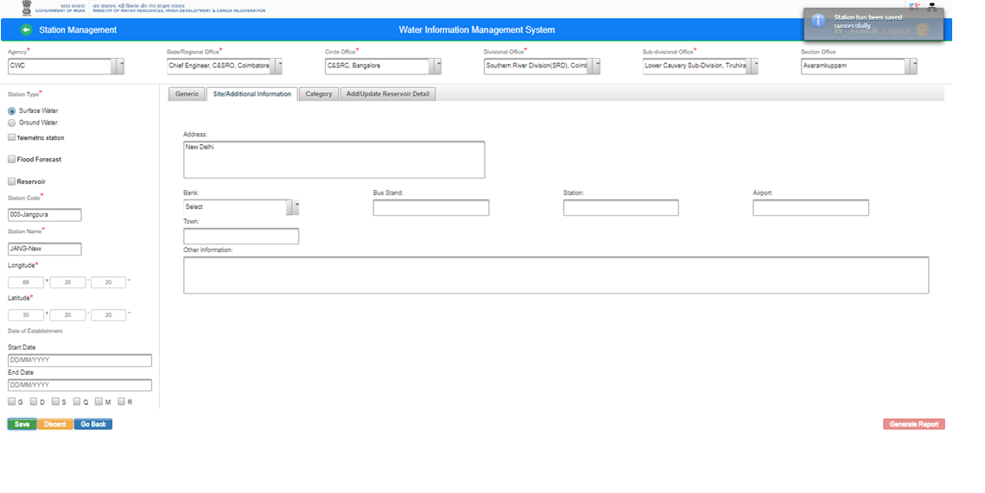
Save Station Characteristics Details: Click on “ Save” button. Station information will be saved in WIMS application and Pop up message will be displayed on screen “Station has been saved successfully”

Slide 30
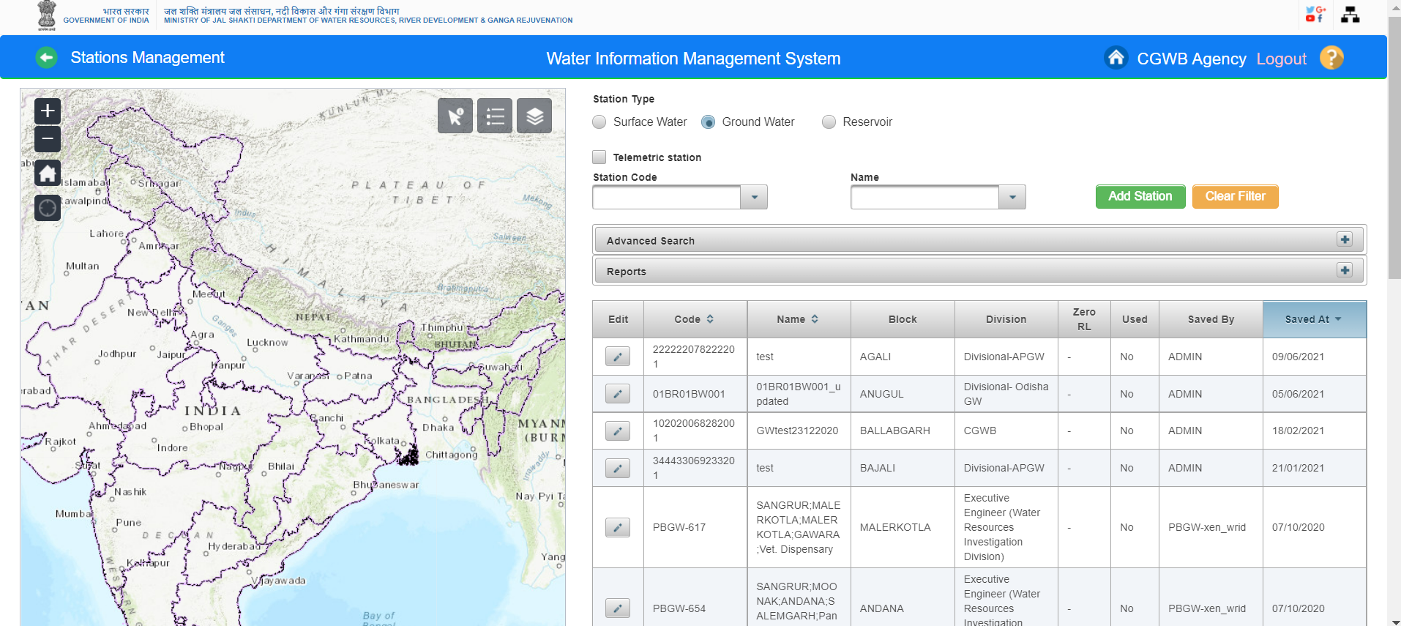
Add New Ground Water Station

Slide 31
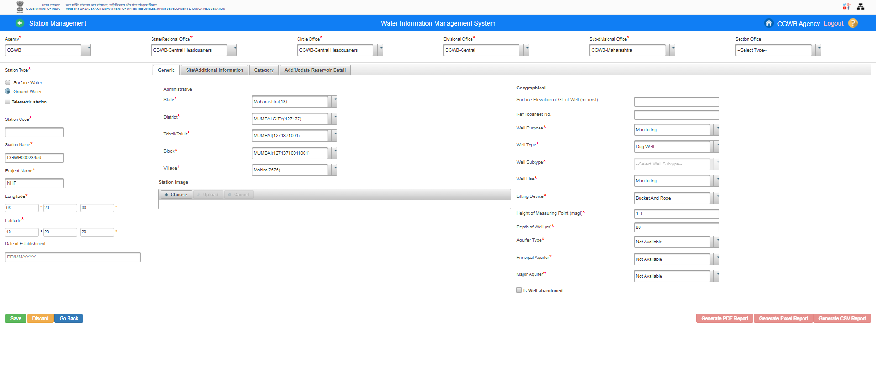
Fill all the mandatory fields on add station page

Slide 32
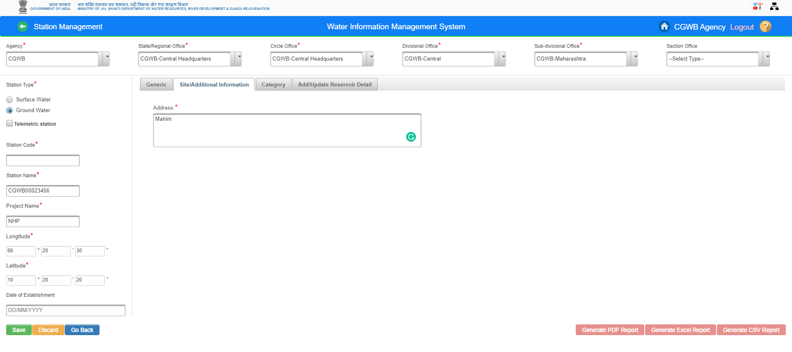
Fill Address for GW Station

Slide 33
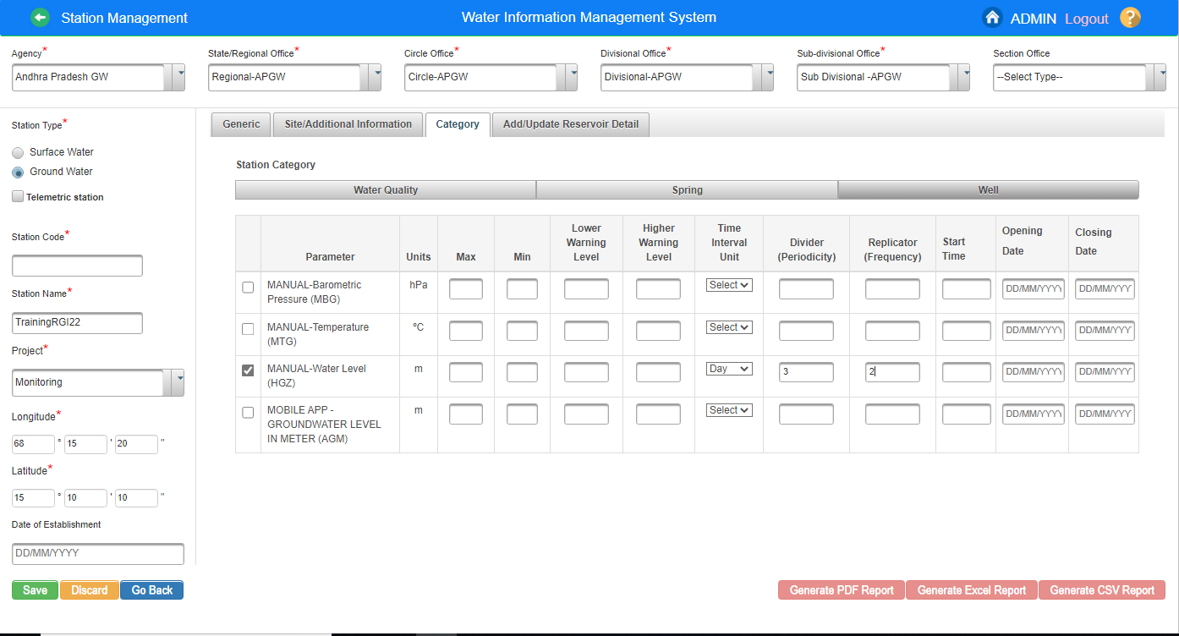
Category under GW

Slide 34
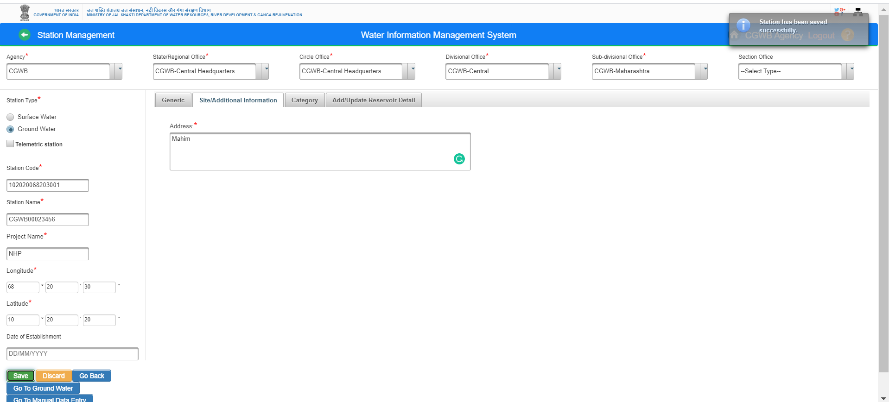
Click on Save button for saving the Ground Water Station details. Ground water station is created successfully

Slide 36
SMS : Select Communication Type “ SMS”

Slide 37
SMS : Select Division office , there after select the Division from the dropdown list

Slide 38
SMS : Select Division office , there after select the Division from the dropdown list .Enter the required data for sending SMS and click on Send SMS button. SM is snt succcessfully

Slide 39
SMS Received

Slide 41
Send Email with Attachment File

Slide 43
Email is sent successfully with attachment file

Slide 45
WIMS- MIS Live Application URL- https://india-water.gov.in/mis
WIMS – MIS

Slide 46
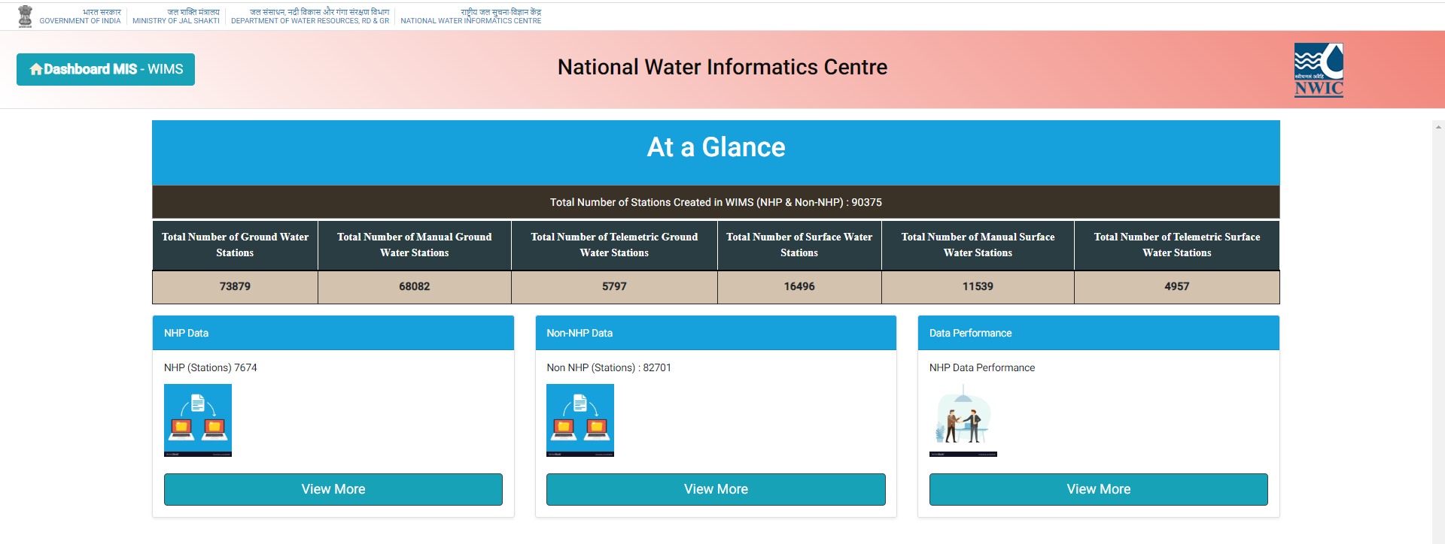
MIS DASHBOARD

Slide 47
NHP Data, Non-NHP Data and Data performance
MIS Dashboard

Slide 48
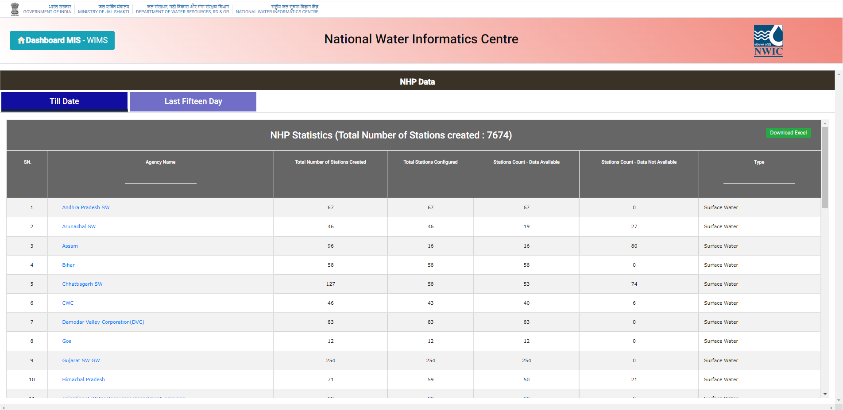
Section: NHP Data Section (Till Date) Till Date Section includes Agency wise-Total Number of Stations Created, Total Stations Configured, Stations Count - Data Available, Stations Count - Data Not Available and Type

Slide 49
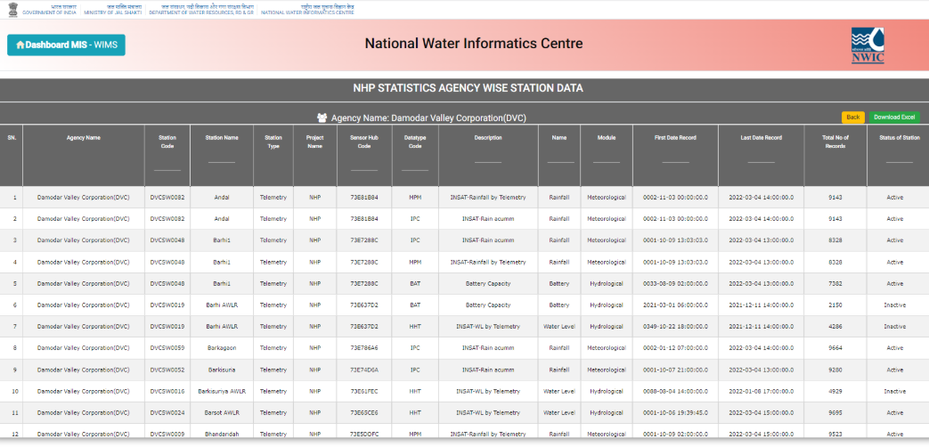
Section: NHP Data Section Till Date Section “All Parameters Data” - Agency Name, Station Code, Station Name, Station Type, Project Name, Sensor Hub Code, Data type Code, Description, Name, Module, First Date Record, Last Date Record, Total No of Records and Status of Station

Slide 50
Section: NHP Data Section (Till Date)
Last Fifteen Day Date Section includes Agency wise-Total Number of Stations Created, Total Stations Configured, Stations Count - Data Available, Stations Count - Data Not Available and Type

Slide 51
Different stations under Agency- Bihar

Slide 52
Last Fifteen Day Section “All Parameters Data” - Agency Name, Station Code, Station Name, Station Type, Project Name, Sensor Hub Code, Data type Code, Description, Name, Module, First Date Record, Last Date Record, Total No of Records and Status of Station

Slide 53
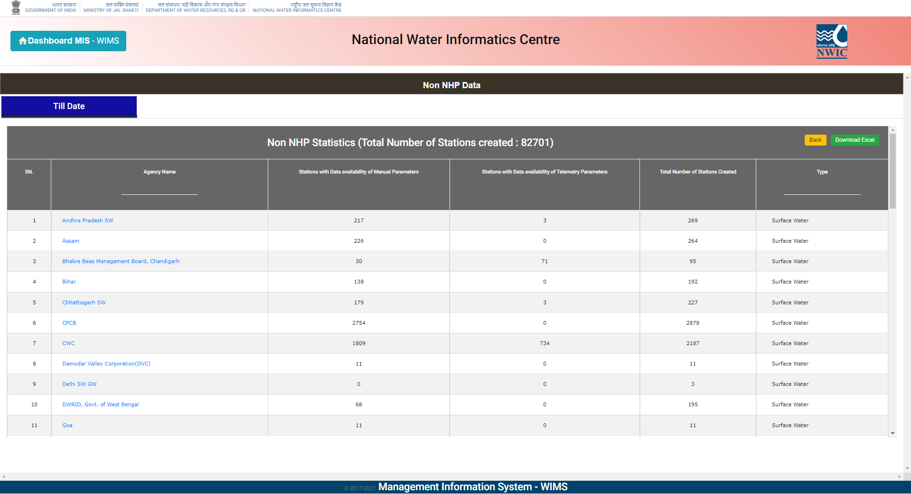
Section: Non-NHP Data Section Till Date Section - Agency Name, Stations with Data availability of Manual Parameters, Stations with Data availability of Telemetry Parameters, Total Number of Stations Created and Type

Slide 54
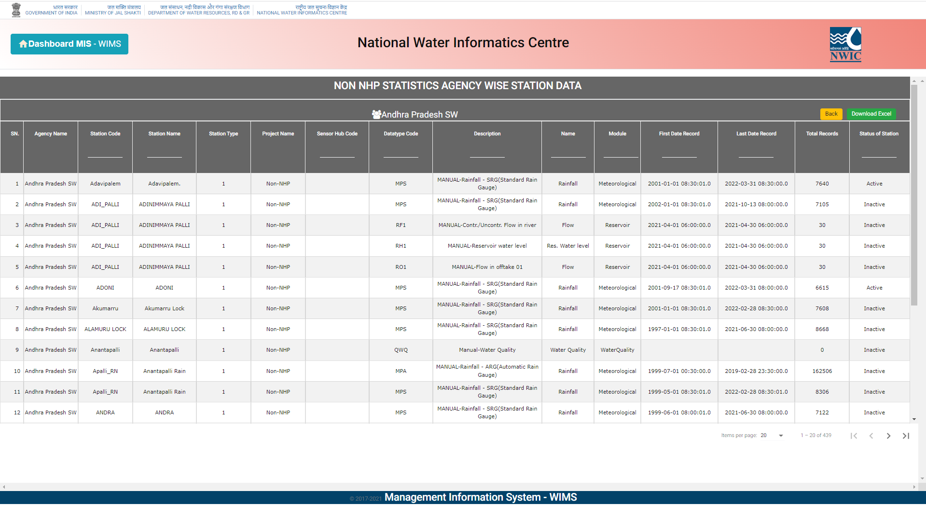
Section: Non-NHP Data Section Till Date Section Agency - Agency Name, Station Code, Station Name, Station Type, Project Name, Sensor Hub Code, Datatype Code, Description, Name, Module, First Date Record, Last Date Record, Total Records and Status of Station.

Slide 55
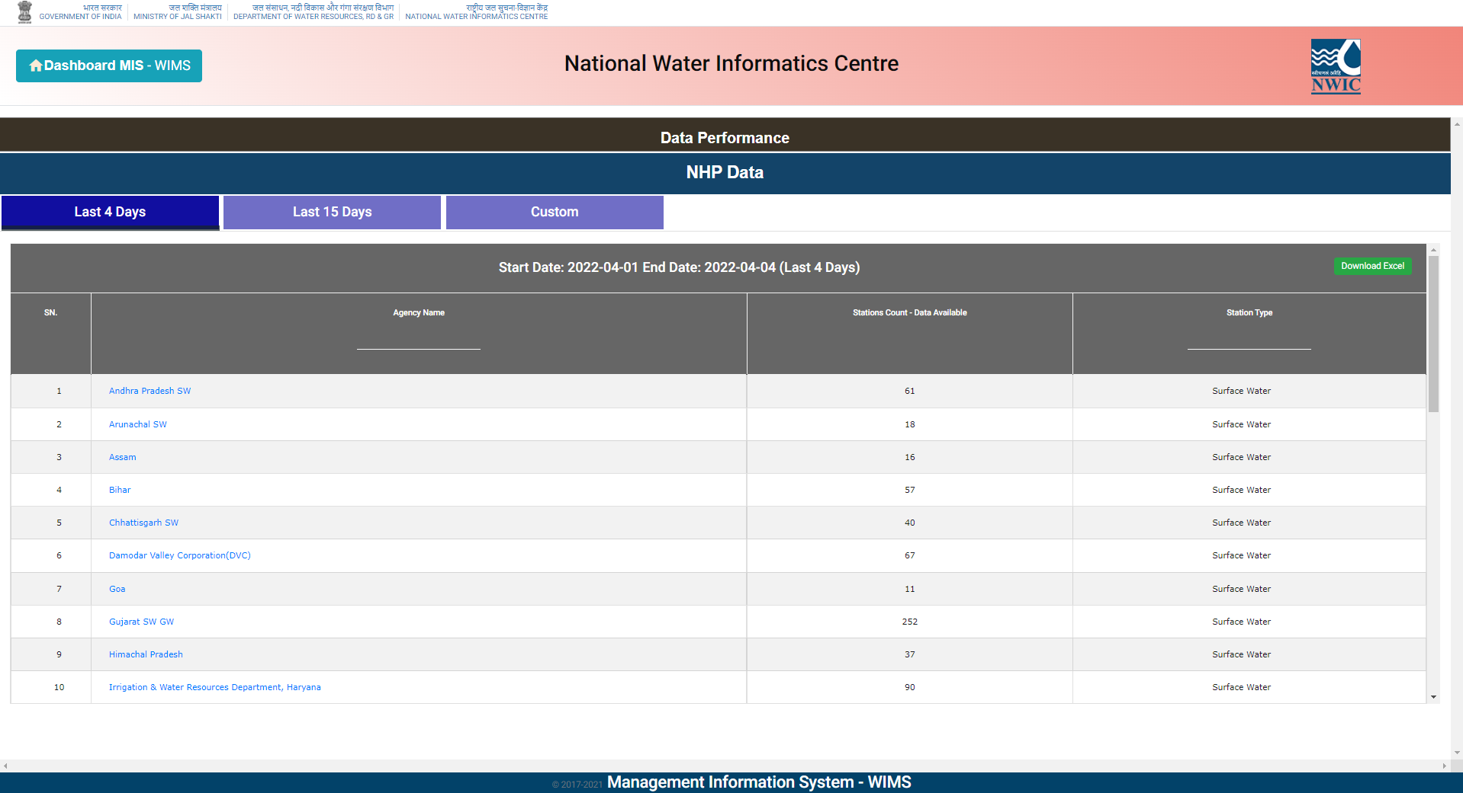
Section: Data Performance Section Last 4 days - Agency Name, Stations Count - Data Available, Station and Type

Slide 56
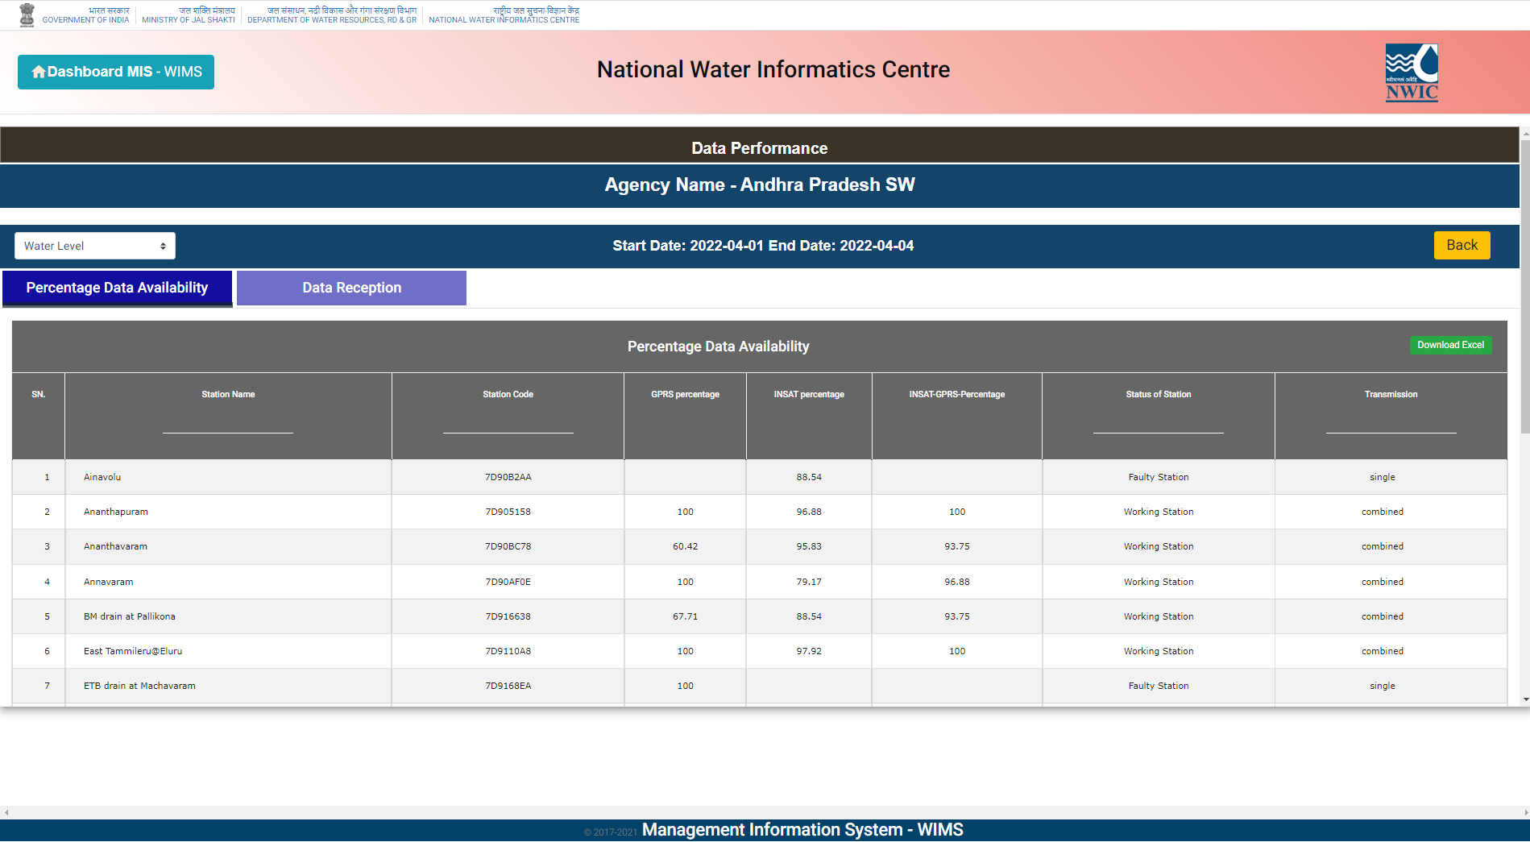
Section: Data Performance Section Last 4 days Agency wise ‘percentage data availability’ for chosen Parameter (Evaporation, Humidity, Pressure, Rain Daily, Rainfall, Temperature, Water Level, Wind Direction and Wind Speed)- Station Name, Station Code, GPRS percentage, INSAT percentage, INSAT-GPRS-Percentage, Status of Station and Transmission.

Slide 57
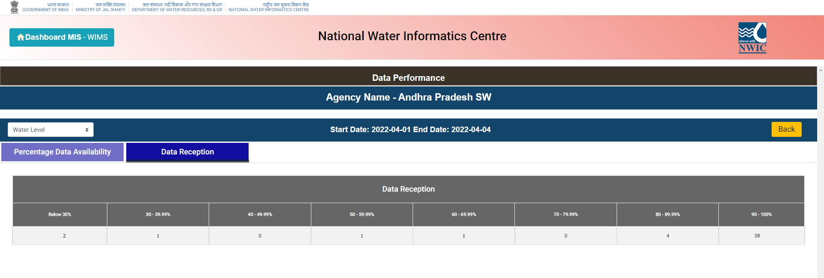
Section: Data Performance Section Last 4 days Agency wise ‘Data Reception Classes’ (Below 30%, 30 - 39.99%, 40 - 49.99%, 50 - 59.99%, 60 - 69.99%, 70 - 79.99%, 80 - 89.99% and 90 – 100%)

Slide 58
Last 15 days Agency wise ‘percentage data availability’ for chosen Parameter (Evaporation, Humidity, Pressure, Rain Daily, Rainfall, Temperature, Water Level, Wind Direction and Wind Speed)- Station Name, Station Code, GPRS percentage, INSAT percentage, INSAT-GPRS-Percentage, Status of Station and Transmission

Slide 59
Questions and Answers with Feedback
For any query & help, you can send email on helpdesk-nwic@gov.in

